Slide 1
Session 1
Angular Bolivia.
By: Ivo Rojas.

Slide 2
Content
Angular Cli.
Git.
Typescript.
Components.
Modules.

Slide 3
Angular Cli
Install.
Create Project.
Create Component.
Create Interface.

Slide 4
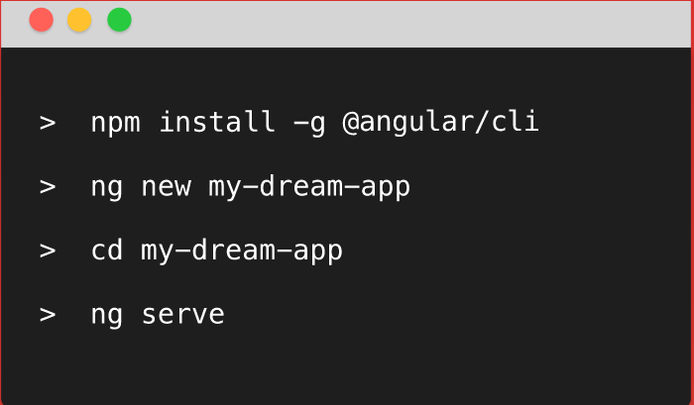
Angular Cli

Slide 5
Angular Cli

Slide 6
Angular Cli
ng g component my-new-component
ng g directive my-new-directive
ng g service my-new-service
ng g class my-new-class
ng g interface my-new-interface
ng g module my-module

Slide 7
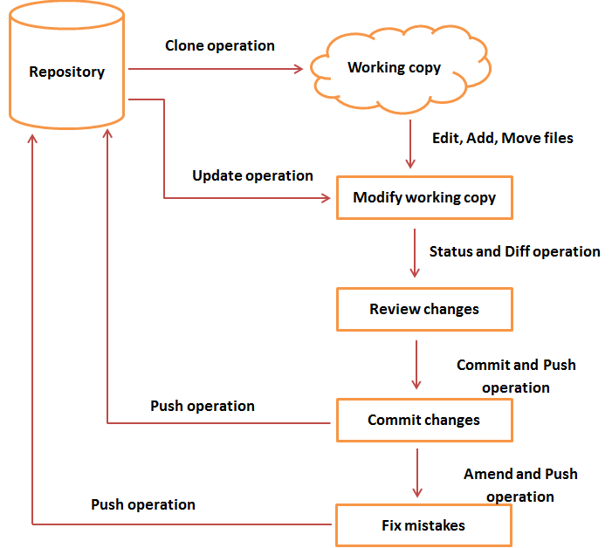
GIT
Git Cycle

Slide 8
GIT
Clone
git clone https://github.com/AngularBoliviaSessions/session01.git

Slide 9
GIT
Edit , Add, Move files.
Update Project.
git pull

Slide 10
GIT
Review Changes.
git Diff

Slide 11
GIT
Save in local.
git commit –m “some message”

Slide 12
GIT
Try upload code to Repository.
git push –u origin master

Slide 13
GIT
If merge conflicts appears, try to fix them.
git diff
git push –u origin master

Slide 14
Typescript
Create class.
Create Interface.
Play with Poo.
Upload to Git classes.

Slide 15
Break
5 mins.

Slide 16
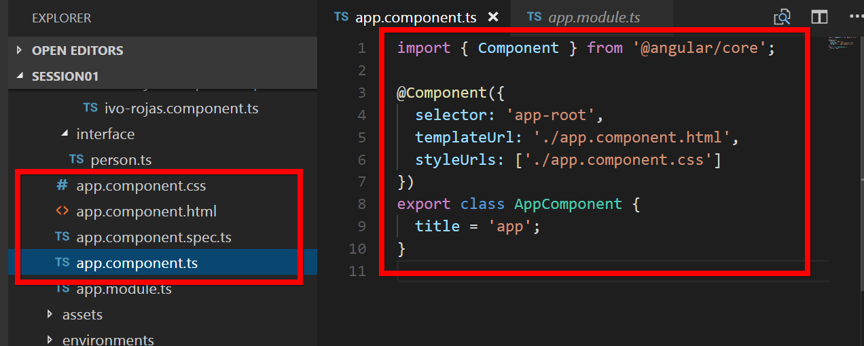
Components

Slide 17
Questions?

